Slide 1
Presented By :
PACHIYAPPAN S
B TECH – IT(3rd Year)
UCEV Villupuram
pachipachi055@gmail.com

Slide 2
CANCER PREDICTION USING DEEP LEARNING(KERAS)

Slide 3
AGENDA:
Problem statement
Project overview
Who are the end users?
Proposed Solution
The wow in my Solution
System Approach
Result
References

Slide 4
PROBLEM STATEMENT:
The project aims to develop a deep learning-based model for cancer prediction, addressing current limitations in accuracy and efficiency.
By leveraging deep neural networks and large-scale datasets, the project seeks to enhance sensitivity and specificity in cancer prediction.

Slide 5
PROJECT OVERVIEW:
The project focuses on developing the cancer prediction system using deep learning.
It addresses current limitations in accuracy and efficiency of traditional prediction methods by leveraging deep learning algorithms.
By training the model on large datasets and optimizing its performance, the project aims to improve sensitivity and specificity in cancer prediction.
Ultimately, the goal is to provide healthcare professionals with a reliable tool for early detection, precise risk assessment, and personalized treatment planning, leading to better patient outcomes and advancements in oncological care.

Slide 6
Who are the End Users:
Medical Professionals
Patients
Healthcare Institutions
Research Institutions
Healthcare Technology Companies
Health Insurance Companies
Government Health Agencies
Clinical Trials

Slide 7
PROPOSED SOLUTION:
Keras is a user-friendly, modular deep learning API written in Python that simplifies the process of building and experimenting with neural networks, offering support for multiple backends and integration with TensorFlow.
Here's some information about Keras:
User-Friendly API
Modularity
Support for Multiple Backends
Flexibility
Extensibility

Slide 8
THE WOW IN MY SOLUTION:
Integration of Advanced Deep Learning Techniques
Personalized Treatment Recommendations
Scalability and Generalization
Clinical Translation and Impact
Interpretability and Explainability

Slide 9
SYSTEM APPROACH:
SYSTEM REQUIREMENTS:-
1. Hardware Requirements:
CPU: While a multicore CPU is adequate for running the training process, training can become computationally intensive. Opting for the fastest CPU available can help minimize training time.
Memory(RAM): A minimum of 8 GB of RAM is advised for effectively managing large datasets and optimizing deep neural network training. Furthermore, a higher RAM capacity could be advantageous for handling larger batch sizes and intricate model architectures.
Internet Connection: To facilitate the download of the MNIST dataset and access online resources or documentation during development, an internet connection is required.

Slide 10
SYSTEM APPROACH – CONT.
2.Software Requirements:
Python: The project is coded using the Python programming language, leveraging its versatility and extensive library ecosystem for efficient development.
TensorFlow/Keras: TensorFlow and its high-level API Keras are instrumental in building and training GAN architectures, simplifying the process and enabling efficient experimentation.
Google Colab: These platforms facilitate interactive development, experimentation, and documentation, promoting dynamic and collaborative workflows.
NumPy: Powerful for numerical computation and array manipulation.
Matplotlib: Matplotlib is used for data visualisation included plotting original, synthetic and augmented data.

Slide 11
MODELLING
FrameworK TensorFlow
Library Numpy
Pandas
Model Sequential model
Artificial neural network (ANN) model
RMSprop optimizer
Binary crossentropy

Slide 12
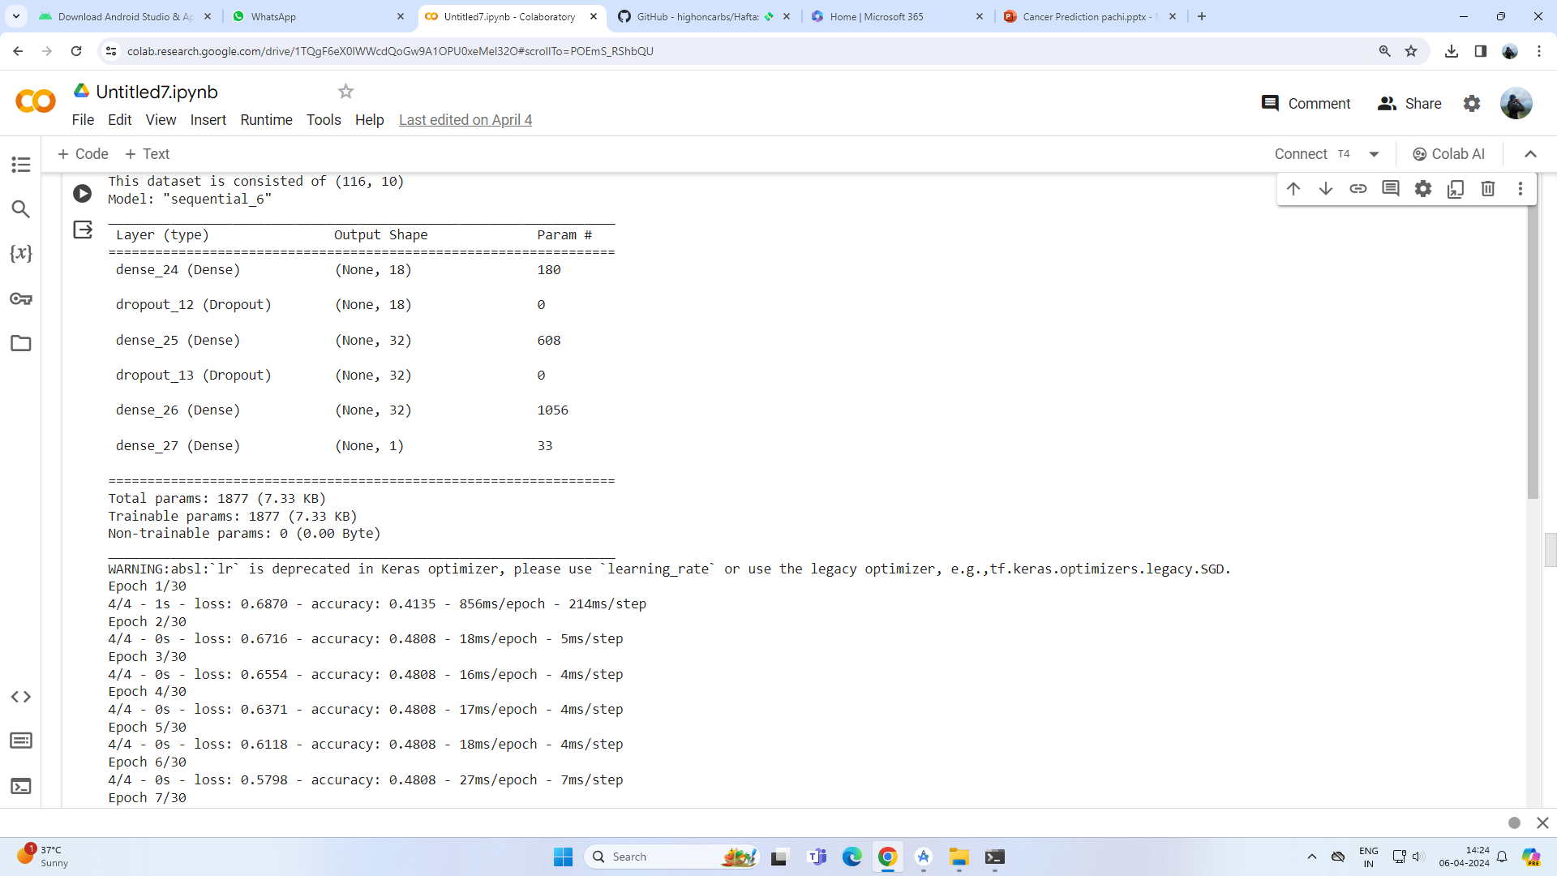
RESULT:

Slide 13
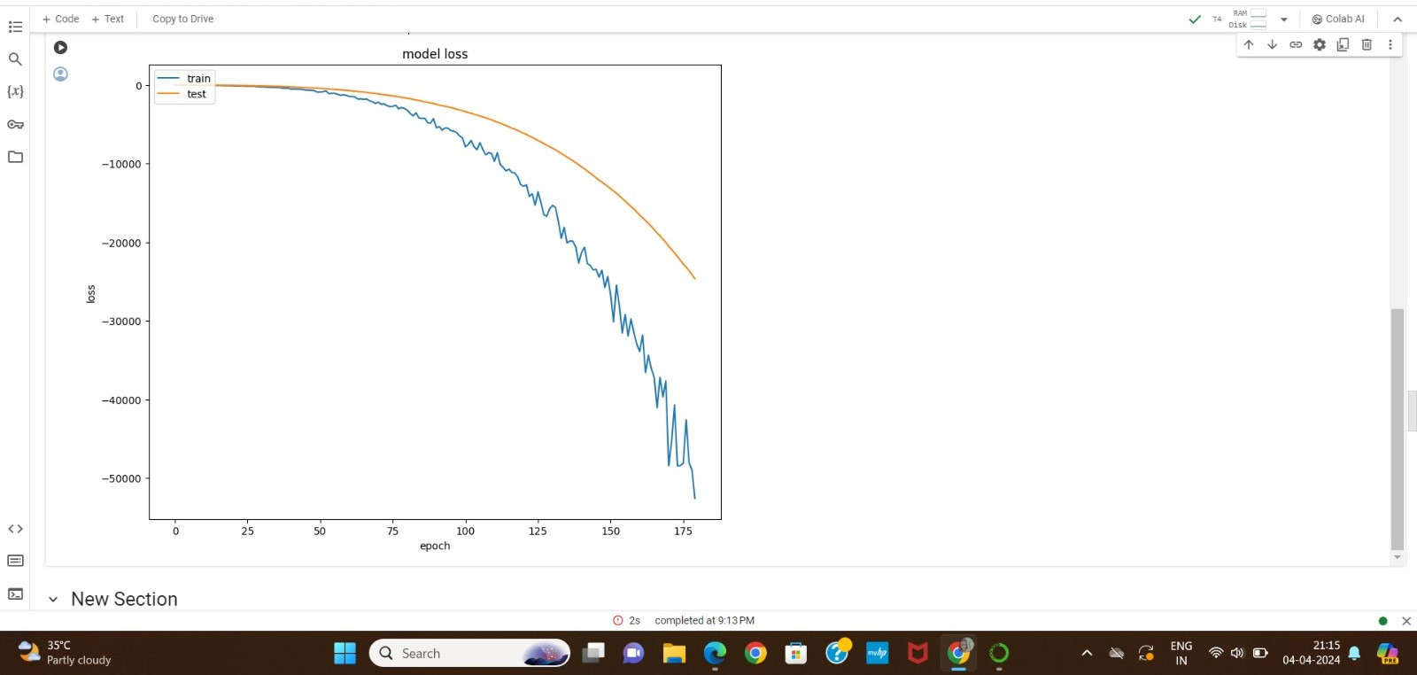

Slide 14
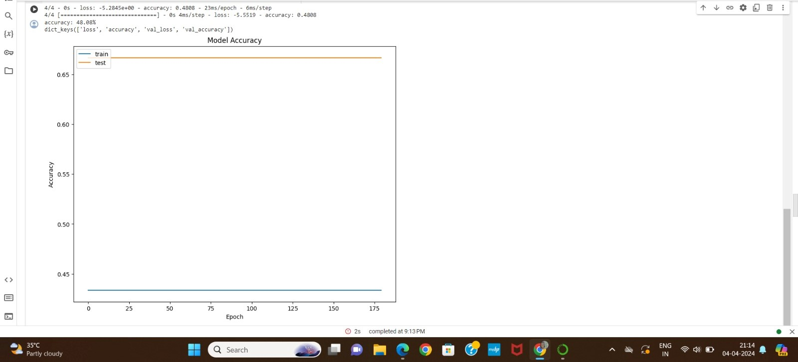

Slide 15
REFERENCES:
https://numpy.org/
https://keras.io/
https://matplotlib.org/
https://www.tensorflow.org/
https://scikit-learn.org/stable/
http://yann.lecun.com/exdb/mnist/
GITHUB LINL:
https://github.com/PACHIYAPPAN-S/TNSTC-GENERATIVE-AI.git

